Slide 1
MSc Artificial Intelligence
Knowledge Engineering
Week 3, 5 October 2026
Notes:
This colour bar is to be used for Artificial Intelligence

Slide 2
Recap
Last week, we:
Understood and practiced how to write logic programs
Understood how logic programming are solved by search
Extended our understanding of logic to include variable, predicates, and quantifiers (first order logic)
This week we will
Review the exercises on first order logic
Understand how to solve first order logic problems using logic programming techniques
Introduce the idea of a knowledge graph and build a simple example

Slide 3
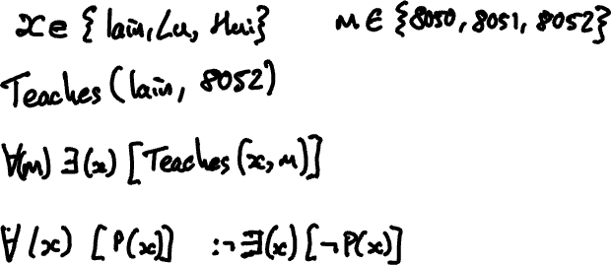
Recap of First Order Logic

Slide 4
Solutions to 1.13 Exercises First Order Logic

Slide 5
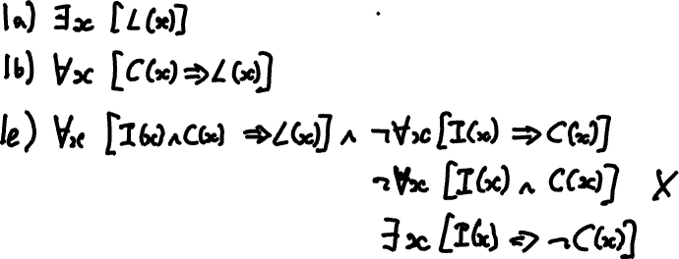

Slide 8
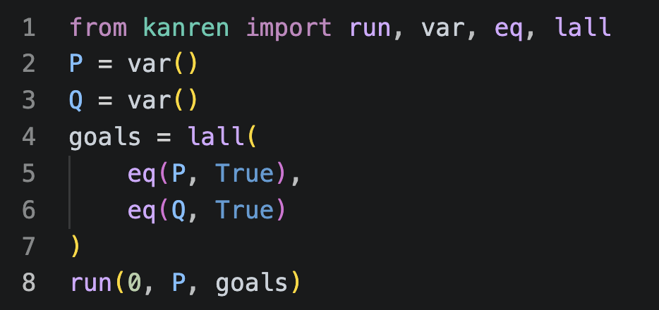
First Order Logic Programming
We have developed an understanding of how to express systems of propositions as a logic program
How do we extend this to First Order Logic?

Slide 9
Open 1.14 First Order Logic in Kanren nocode.ipynb and code along.

Slide 10
Now try yourself
1.15 Exercises First Order Logic Kanren.ipynb

Slide 11
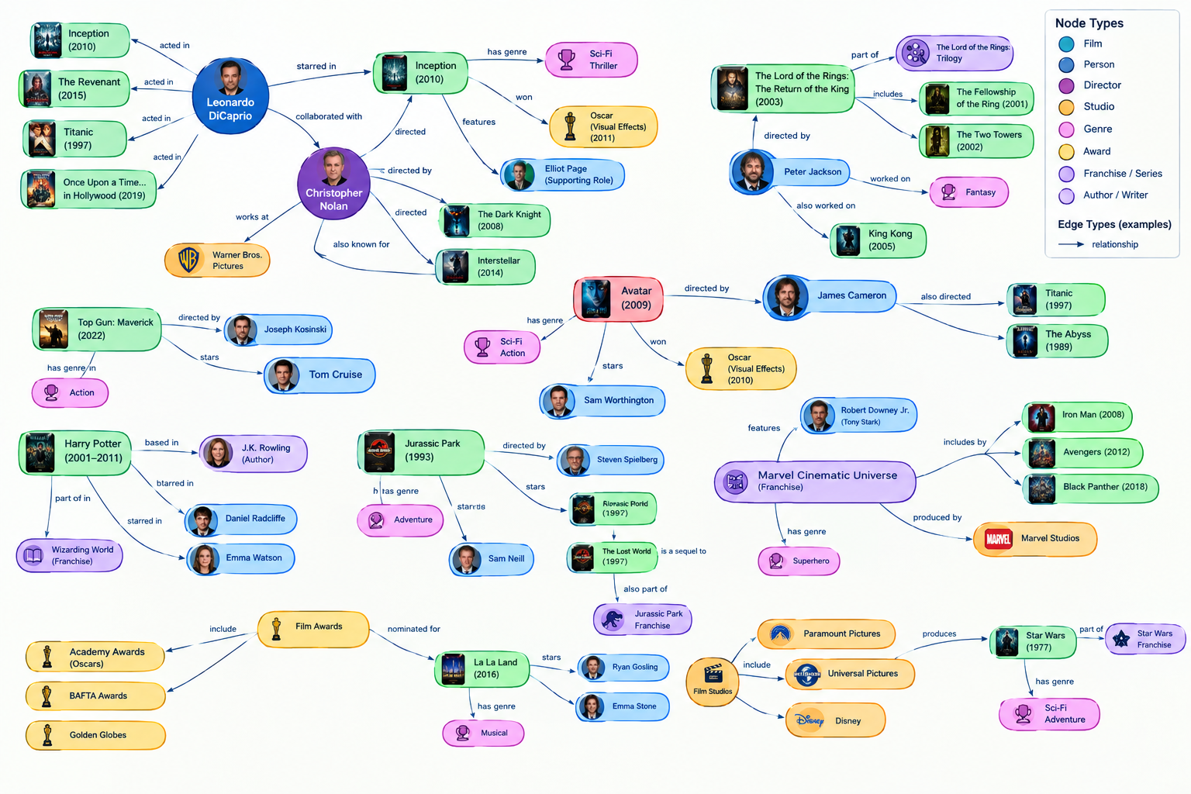
Graph Representations of Knowledge

Slide 12
A look back at knowledge bases
Knowledge Bases provide one means of representing our knowledge of the world
  Robust mechanisms for querying
  Can produce new knowledge (new sentences)
  Easily updated
  Rigourous inference
  Human readable in principle

Slide 13
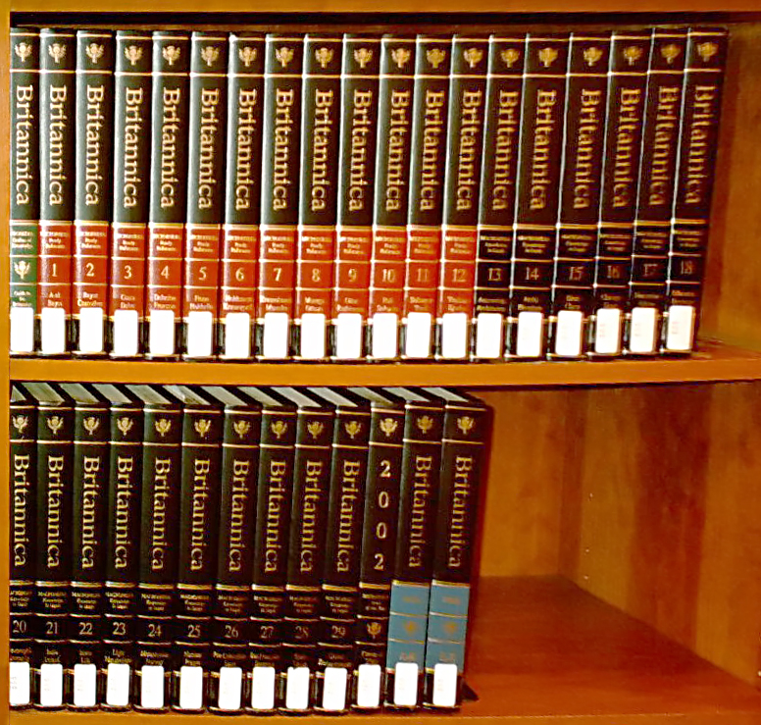
Limitations of Knowledge Bases
  Not scalable
  Labour intensive, requiring extensive subject matter expertise
  Relationships not especially transparent
  No annotations
  Logic programming not intuitive to most programmers used to other paradigms

Slide 14
Limitations of Knowledge Bases
  First order logic overcomes some of these
  Explicitly models relationships
  Introduces a notion of “types” through variable domains which prevents for example:
  Teaches(“T. Rex”, “ECS8052”)

Slide 15
Overcoming these Limitations
There are many things we would like KB to do:
Explicitly model relationships between entities
Allow the “atomic units of knowledge” to be annotated with additional information
Support performant and accurate inference
Scale to very large numbers of “atoms”.
Support highly parallel querying
Interpretable by humans
Readable by machines
Enter the knowledge graph

Slide 16
A Knowledge Base in First Order Logic
Student(Alice)
Student(Bob)
Student(Chen)
Professor(Diana)
Professor(Edward)
Professor(Faye)
Course(AI)
Module(ECS8050)
Module(ECS8051)
Module(ECS8052)
Enrolled(Alice,AI)
Enrolled(Bob,AI)
Enrolled(Chen,AI)
Teaches(Diana,ECS8050)
Teaches(Edward,ECS8051)
Teaches(Faye,ECS8052)
Requires(AI,ECS8050)
Requires(AI,ECS8051)
Requires(AI,ECS8052)
Passed(Alice,ECS8050)
Passed(Alice,ECS8051)
Passed(Alice,ECS8052)
Passed(Bob,ECS8050)
Passed(Bob,ECS8052)
Passed(Chen,ECS8050)
Passed(Chen,ECS8051)
Passed(Chen,ECS8052)
This is a Graph!
Unary Predicates correspond to nodes in the graph
Binary Predicates correspond to directed edges

Slide 17
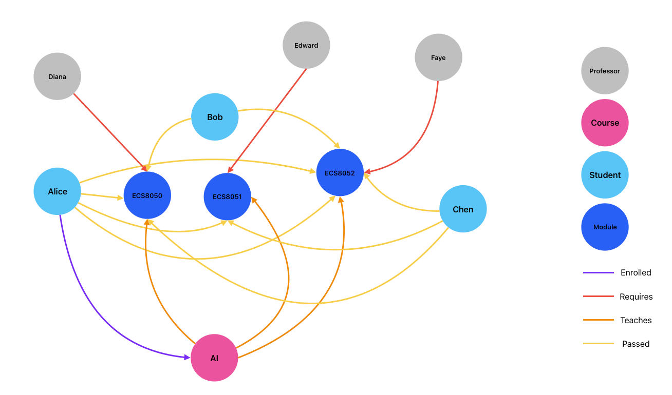

A Simple Knowledge Graph

Slide 18

What is a Knowledge Graph
A Knowledge Base, structured on a graph
Defines the “things” that our knowledge is about – the nodes of the graph
Defines the relationships between the “things’” – the edges of the graph
Defines the properties of the “things” – the attributes of the nodes
Rich structure, often with substructure (clustering of nodes)
Normalised
Explicit and declarative – has an intended meaning and is itself meaningful
Often large – millions of nodes or more
Human and machine readable

Slide 19
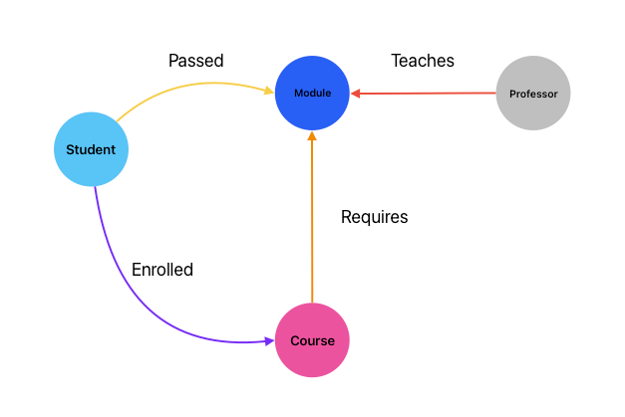
A simple example
Nodes in the graph represent "things" (entities).
Edges in the graph represent relationships between the entities.
Nodes and Edges can have a type that specified the nature of the entity or relationship.
Structure is governed by a "grammar" or schema/ontology.
Nodes and Edges can have attributes (properties).
The graph is properly normalised, with each entity and relationship represented only once.
The graph is explicit and declarative, and has intrinsic meaning.
Readable by both humans and machines.
Scales efficiently, often to millions of nodes.

Slide 20
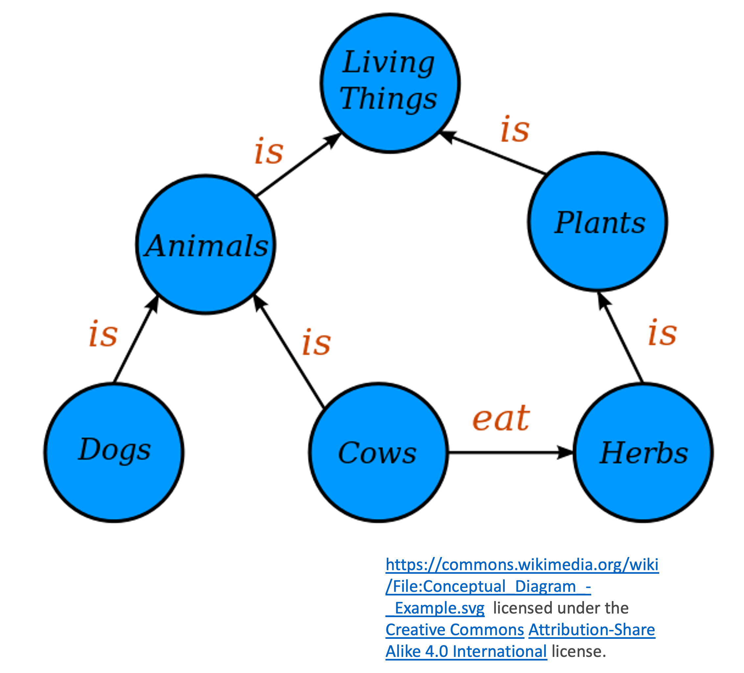
Another Example of an Ontology

Slide 21
What’s wrong with a Relational DB?
All of this could be done with a SQL database
The information is there, but it is hardly transparent
Information spread over many tables
Not really human readable
In Graphs:
Relationships are represented directly,
Naturally normalised and human-readable
Entities that are related to each other are close in the graph.
uid (PK) | staffID | Name
1 | 12345 | Iain Styles
2 | 54321 | Hui Wang
3 | 12321 | Lu Bai
uid (PK) | moduleID | Name | Taught By
11 | 45678 | Knowledge Engineering | 12345
12 | 56789 | Machine Learning | 54321
33 | 67890 | Intro to AI | 12321

Slide 22
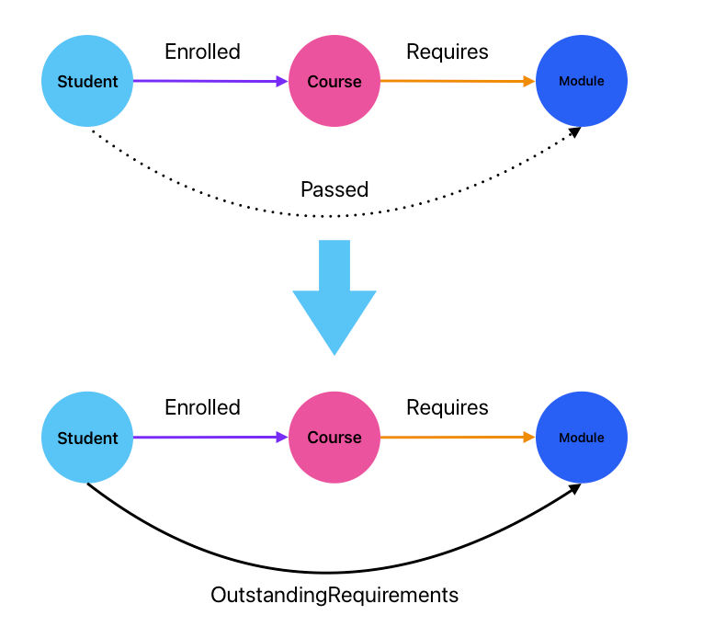

Graphs permit easy inference
Student(s)∧Module(m)∧∃c:[Course(c)∧Enrolled(s,c)∧Requires(c,m)∧¬Passed(s,m)⟹OutstandingRequirements(s,m)

Slide 23
2.01 Exercises Designing a Knowledge Graph

Slide 24
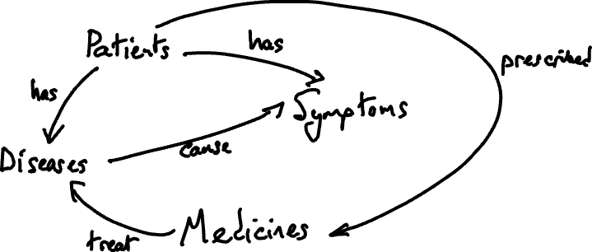

Slide 25
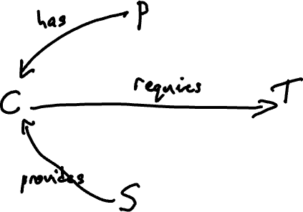

Slide 26
Graphs in Kanren
Kanren provides mechanisms for defining graph-like structures
We will now explore these
We will move to more sophisticated platforms, but this provides a good bridge across
Open 2.03 A Simple Knowledge Graph in Kanren nocode.ipynb and code along

Slide 27
Graphs in Kanren
Kanren provides mechanisms for defining graph-like structures
We will now explore these
We will move to more sophisticated platforms, but this provides a good bridge across
Open 2.03 A Simple Knowledge Graph in Kanren nocode.ipynb and code along
Now you have a go:
2.04 Exercises on Simple Knowledge Graph.ipynb

